Slide 1







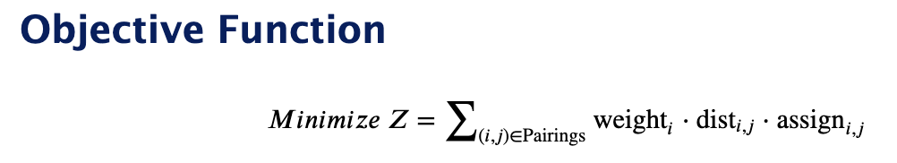
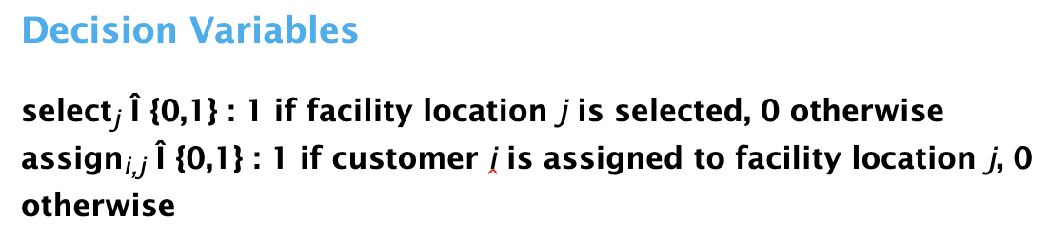



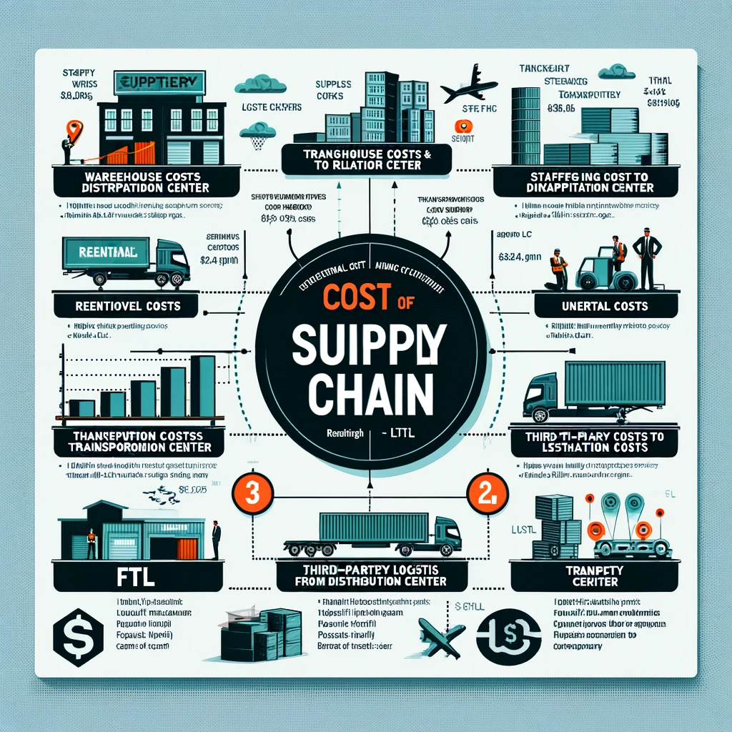

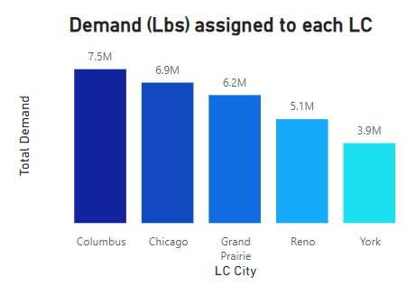
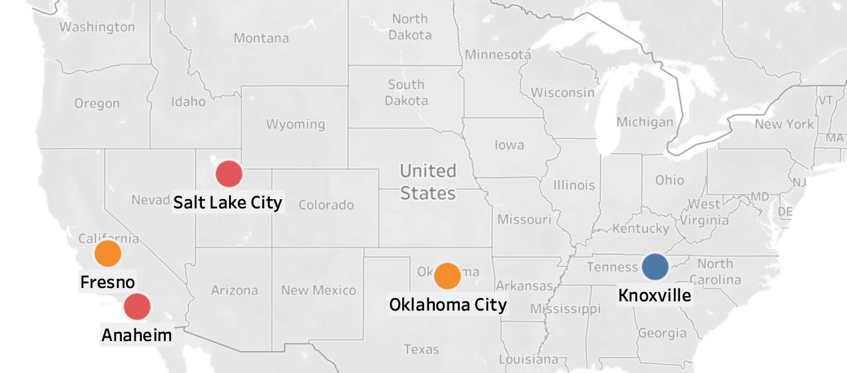

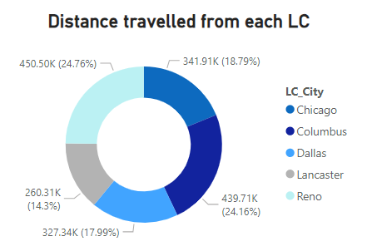

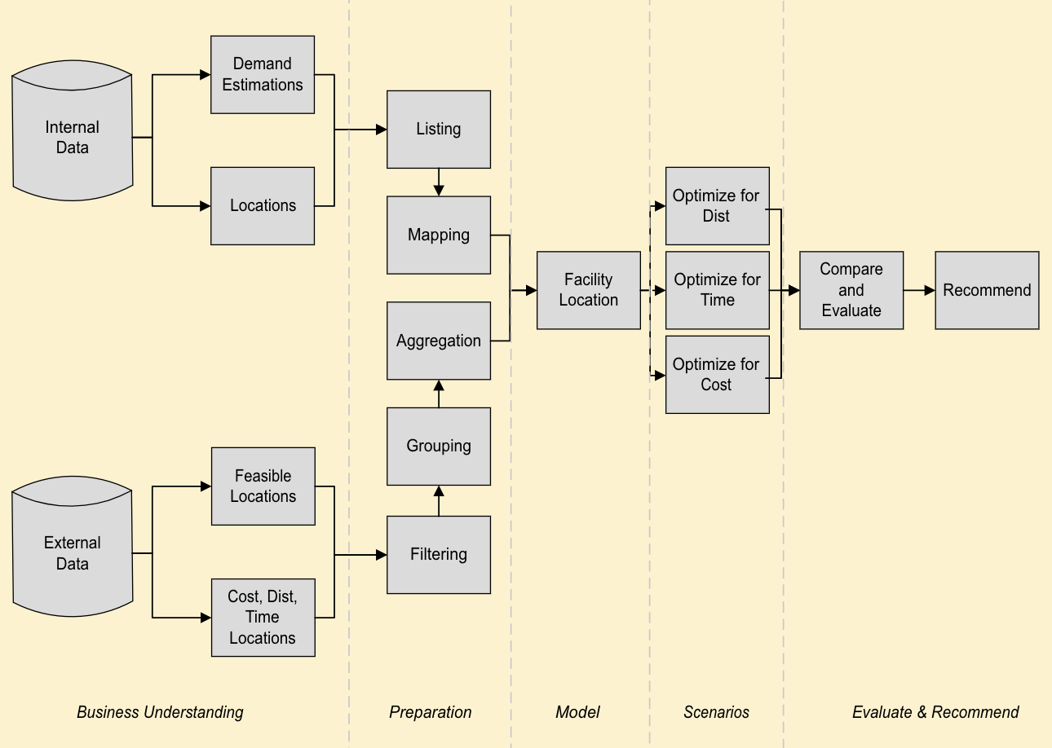


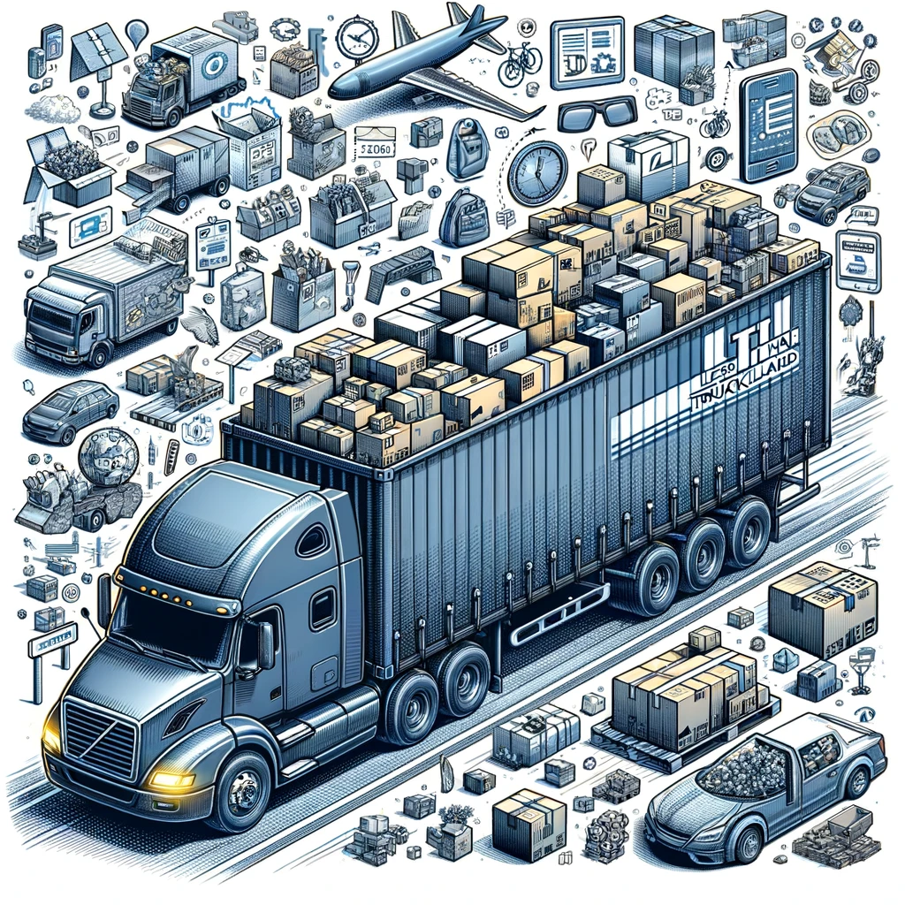
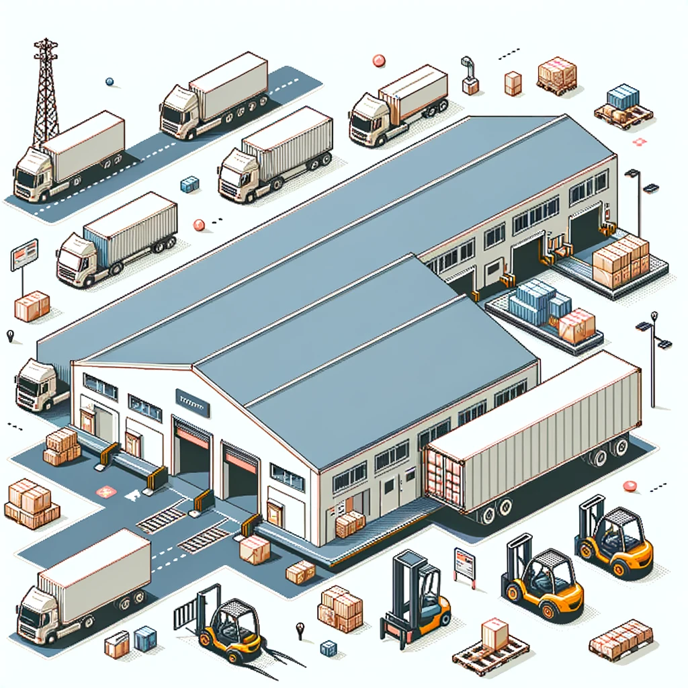









Data Pre-Processing
Advanced Network Solutions for Supply Chain Excellence
Analytical Problem Framing
Nagarjuna Chidarala | Vishnu Ponduri | Madhur Khanna | Cole Welesly | Priyam Sarkar | Matthew Lanham
Business Problem Framing
Data Sources
Model
In a rapidly shifting global economy, optimizing supply chain networks is critical. Supply Chain network optimization results in considerable cost savings and improved operational visibility, illustrated by example of a global manufacturer saving $60 million (*Supply Chain Brain 2022).
Develop a robust clustering model utilizing Weighted K-Means algorithm to conduct a Green Field Analysis for identifying optimal locations for Logistic Centre.
Design and implement a multi-scenario optimization model to evaluate the trade-offs between cost-efficiency and service quality.
External
Below Formulation is used for analysis :
Internal
1
Constraints
1
2
Inbound and Outbound Logistic expense
3
EDA and Insights
Commercial Property Valuation and Market Analysis
Source :usa.gov
2
Geospatial Positioning and Distance Metrics by Geocoder API
1
1.Facilities Limit : Number of facilities opened cannot exceed the limit
2.Open to assign: Customer i can only be assigned to facility j only if that facility is built
3. Assign to nearest facility: Customer i must be assigned to exactly one facility
Demand Forecasting
at different Geography
Warehouse Operational Economics
Demographical Data for feasible LC and DC location
Technical Aspects:
Technical Aspects:
Data pre-processing
Iterative model refinement
Application LP /MILP
Parameter Analysis
Scenario Analysis
LC to DC
DC to Customers
Null Value Imputation
For Categorical Variables employed mode imputation
For Continuous Variables utilized median imputation
Streamlining Distribution by Direct Fulfilment from 5 Logistic Centres
Integration of 3 Logistic Centres with Current DC Network
1
2a
Our client confronts the challenge of scaling its supply chain to match its evolutions. Thus, they came up with :
Data Integration via Pandas
Used data manipulation, merging disparate datasets into a single cohesive data frame.
When Service Level is taken into consideration, Dallas and Lancaster came out as LC location instead Grand Prairie and York, Respectively.
Data Normalization
Standardized naming conventions across the dataset, resolving discrepancies in entity representation to avoid redundancy and confusion.
Scenario 1 : Cost Minimization
1
Identify five key LC locations for a brand-new distribution network optimized for cost and service.
LC location for Cost optimized scenario
LC location for Service optimized scenario
Regional Demand and Shipping Cost Analysis
Cost Discrepancy Alert
15% of total demand is travelling more than 2000 miles, which is impacting the overall logistic cost.
LC location for both the scenario
2
*keeping all the existing DC but optimizing the assignment to customer
Enhancing an existing network by optimizing LC locations and evaluating the cost-effectiveness.
While optimizing for service, 65 % of total demand travels less than 100 miles compare to 57% in case of cost optimization.
2b
Midwest Cost Peak
Midwest region exhibits lower cost efficiency, with a cost/mile of $2.07 surpassing the $1.06 average.
Scenario 2 : Service Optimization
When replacing Buena Park , Fresno and North Las Vegas produced the optimal location for Cost Minimization and Service Level while keeping Burford and Grand Prairie.
Constraints
Business Level
Logistics
Costly Service Centre
The unit service cost for the two highest demand-serving warehouses exceeds the overall average.
1)Population Threshold >200k for setting up LC
2)Approximation of demand
Restriction on the availability of 3PL for Last Mile delivery
*in Millions
Baseline Comparison with our Model
Service vs Cost Trade off
Service Cost Optimisation
Methodology
With 5 LC
With 3 LC
With 5 LC
Stakeholders
*No of ZIP Codes
>$5.00
Opportunities to keep the Service Cost lower for 922 cities contributed to 39% of total demand
$4.00 – $4.99
922
$3.00 – $3.99
Distance calculated in Million miles
Weight calculated in Million lbs
178
$2.00 - $2.99
Deployment and LCM
Logistic Partner
Warehouse owner
Distributors
241
485
$1.00 - $1.99
Potential Benefit
1317
*in Million USD
21%
However, as we have mostly two scenarios to address, our solution would differ in two case :
Future Scope
Reduced logistic cost
Lower delivery time
Scalability
Resilience
Cost ($)
Complete fulfilment of demand across regions
Weighted Distance and distance is used as a proxy of Cost and service respectively
A circuity factor is 1.17 to convert the Haversine distance into actual distance
Truck travel time 10 hours day
Success Metrics
Reduction of 15% in total
Distance travelled
Increase savings by 35% in Transportation cost
Assess the demand seasonality and include the same in supply chain network design
Inventory optimisation for each LC & DC to be undertaken to execute the solution effectively.
Service Cost of fewer cities would lie in the range at >$5
Miles travelled for the cities contributed higher demand would be lesser
For top contributing DC, Service Cost to be proportionate to the demand catered
Transportation
Cost
2.3
1.8
Warehouse
Cost
4.3
3.4
Once done, result will be conveyed to stakeholder through an interactive Power BI dashboard.
Before
After

